Slide 1


Hope to Skills
Lecture# 21
Irfan Malik, Dr. Sheraz Naseer

Slide 2
Agenda
Problem with linear Models
Neural Networks
Why Neural Networks
Play ground
Quiz

Slide 3
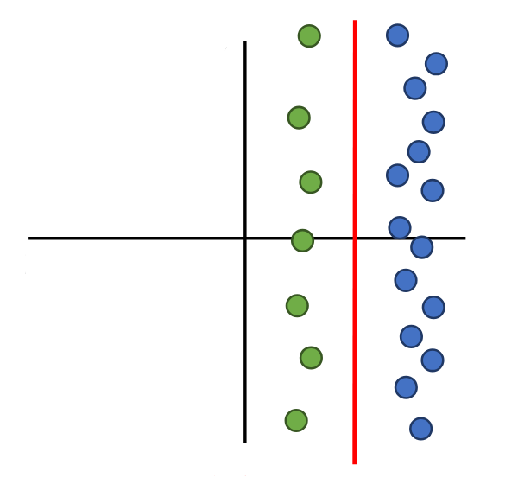
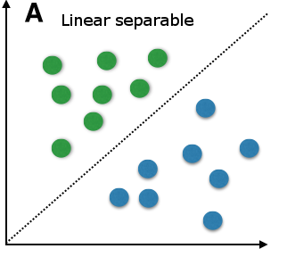
Linear Models

Slide 4
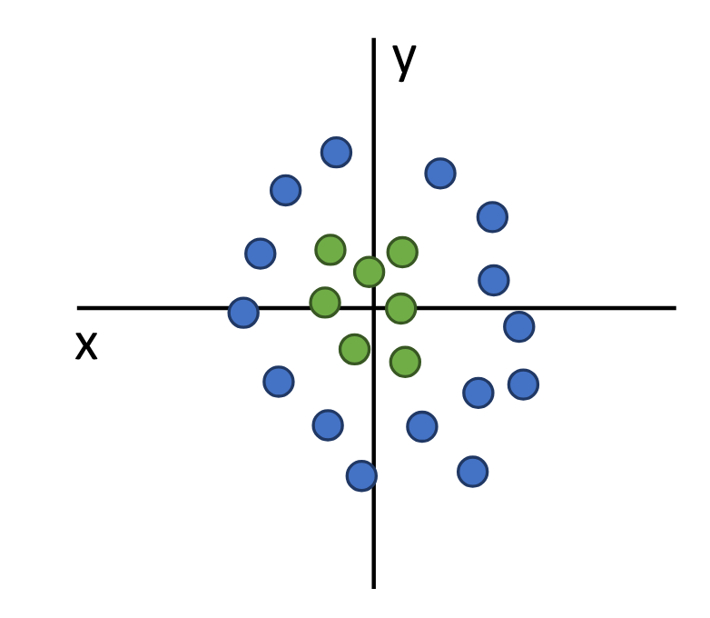
Problem with Linear Models

Slide 5
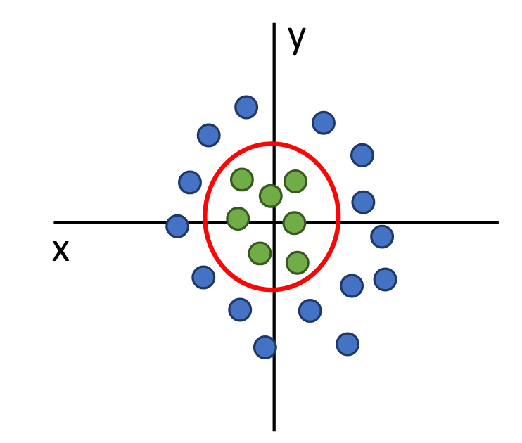
Problem with Linear Models

Slide 6
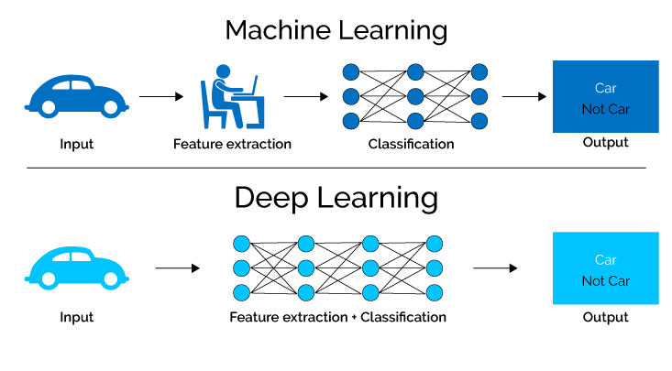
Welcome to Deep Learning..!

Slide 7
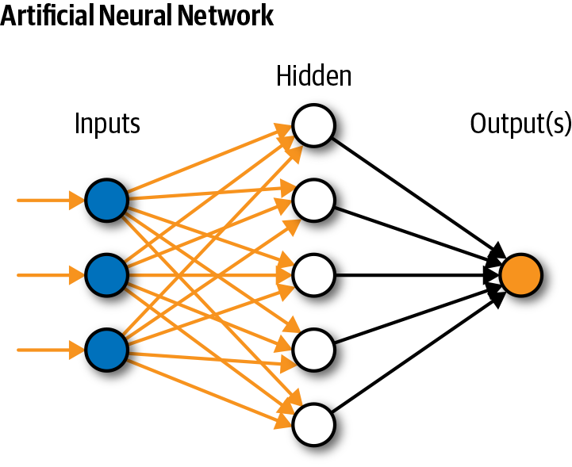
Simple Neural Network

Slide 8
What is TensorFlow?
TensorFlow is an open-source machine learning framework developed by Google.
It enables building, training, and deploying machine learning models.
Primarily used for deep learning tasks, it's versatile for various other types of machine learning.
Tensorflow

Slide 9
Let Move to Playground

